Slide 1
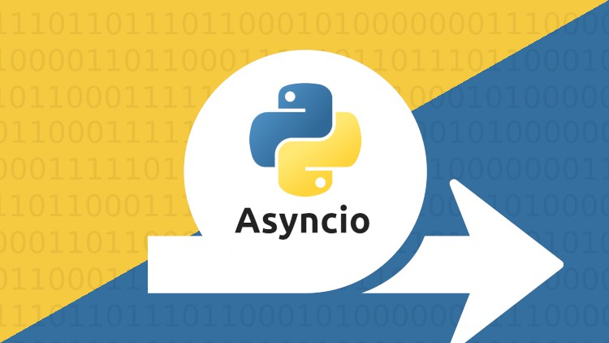
Welcome & Module Induction
What we learned previously: In Module 12, we used Multi-threading and Multiprocessing to run tasks in parallel.
What we are learning today: We are learning the "Next Generation" of concurrency: Asynchronous Programming. We will master the Event Loop, the async/await keywords, and the power of Non-blocking I/O.
Why this will be helpful: In modern AI and Web frameworks (like FastAPI), asyncio is the secret to extreme speed. While a Threaded app might handle 100 users, an Asynchronous app can handle 10,000 on the same hardware. This is essential for building real-time AI agents and high-speed data scrapers.

Slide 2
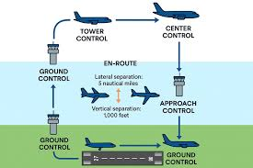
The Event Loop (The Air Traffic Controller)
The Problem: In normal code, your script stops and waits for every task.
The Solution: The Event Loop. It is a continuous loop that monitors tasks. If one task is waiting for the internet, the loop "pauses" it and immediately starts the next task.
The Goal: Never let the CPU sit idle. Keep the "loop" spinning at all times.

Slide 3
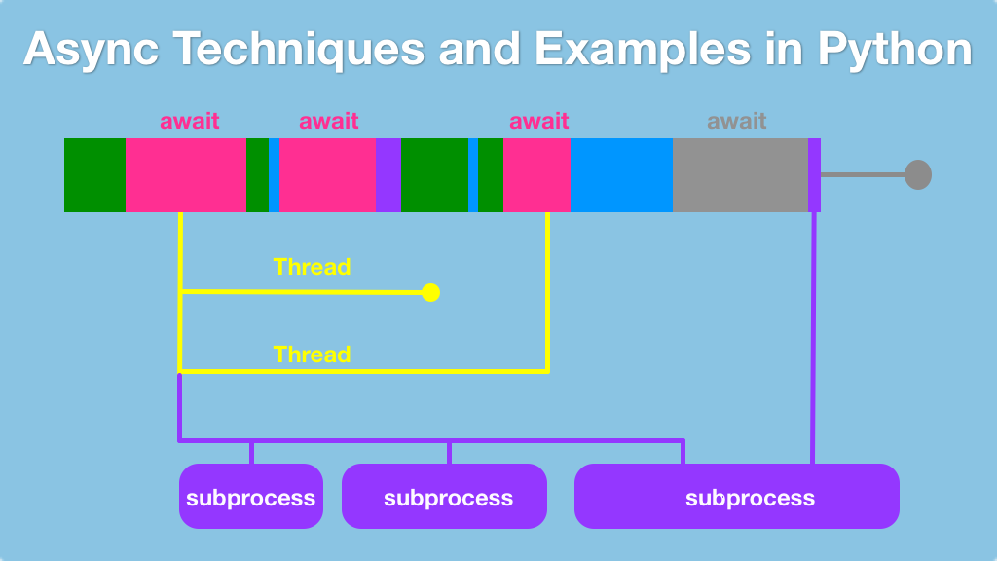
async and await (The Modern Syntax)
async def: This turns a normal function into a "Coroutine." It tells Python, "This function is allowed to pause itself."
await: This is the pause button. It tells Python, "Go do other work until this specific line is finished."
The Clean Code Advantage: Unlike older methods, async/await makes non-blocking code look and feel like a standard, readable script.

Slide 4
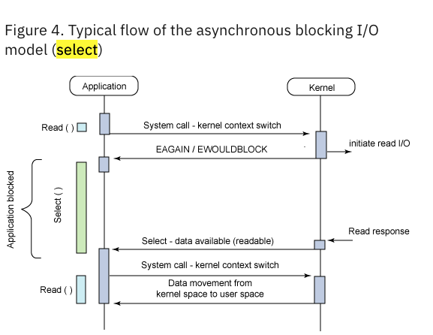
Non-blocking I/O (Fluid Systems)
Blocking: Your app "freezes" while waiting for a database or a website. The user sees a spinning wheel.
Non-blocking: Your app stays responsive. It can continue to process user clicks or other data while the "slow" database work happens in the background.

